Slide 1
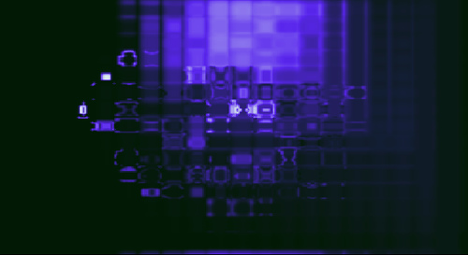
Digital Preservation and Copyright
in Australia
July 2008
Professor Brian Fitzgerald and Jessica Coates
Open Access to Knowledge (OAK) Law
Queensland University of Technology
Image: Blue by heyjoewhereyougoinwiththatguninyourhand from http://www.flickr.com/photos/heyjoewhereyougoingwiththatguninyourhand/69725913/ under a Creative Commons Attribution 2.0 licence

Slide 2
Copyright in Australia
Copyright Act 1968
Protects ‘works’ (literary, artistic, musical and dramatic), as well as ‘other subject matter’ (films, sound recordings, broadcasts, published editions)
Standard fair dealing exceptions (research, criticism, news, legal advice, parody and satire) plus a large number of very specific exceptions for certain uses (eg format shifting) and users (eg libraries)

Slide 3
Library and Archive Exceptions
Part III, Division 5 & s110B
Various exceptions for non-profit libraries, archives, galleries and museums – including those run by for-profit entities, as long as they are accessible to the public
ss51A (works) and 110B (films and sound recordings) allow preservation of any work in the collection but:
  s51A only applies where the material is already lost/deteriorated
  both only apply to published material where it isn’t ‘available in a reasonable time at an ordinary commercial price’

Slide 4
Key Cultural Institutions
ss51B, 110BA and 112AA
Introduced in 2007 as a result of a major ‘Fair Use’ review
Intended to allow international best-practice preservation
‘Key cultural institutions’ can make 3 copies of material of ‘historical or cultural significance to Australia’ to preserve it against loss or deterioration
‘Key cultural institution’ = those empowered by legislation (ie State and Federal collections)
For published material, again, only applies where not otherwise commercially available

Slide 5
Three Step Test Exception
s200AB – again introduced in 2007
Intended to add flexibility to the Act (instead of US-style fair use)
Only applies to certain categories of users – libraries and archives, educational institutions, those assisting people with disabilities
Allows uses which comply with the Berne three step test, ie must:
  not conflict with a normal exploitation of the work or other subject‑matter;
  not unreasonably prejudice the legitimate interests of the © owner; and
  be a ‘special case’.
In addition must:
  be for the purpose of maintaining or operating the library; and
  not be commercially available.
Application is uncertain – but definitely no large scale projects

Slide 6
Other Legal Issues
Legal deposit? s201
  Federal – limited to printed materials
  Tasmania and Northern Territory – incl. digital
How can materials be accessed?
  on library premises (s51A and 110B)
  works (but not sound recordings or films) can be communicated off site in response to user requests for research and study (s49)

Slide 7
Digital Preservation Landscape
Almost all digital preservation conducted by government funded libraries, archives and museums (some universities)
Primarily with the author’s agreement
Various efforts to establish guidelines and raise awareness – but mainly ad hoc

Slide 8
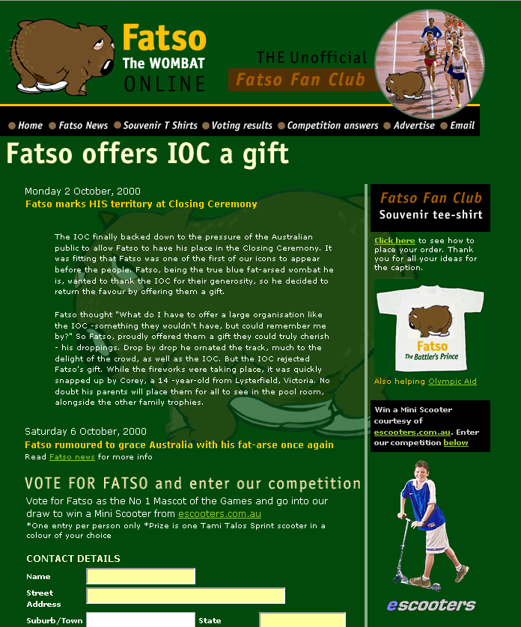
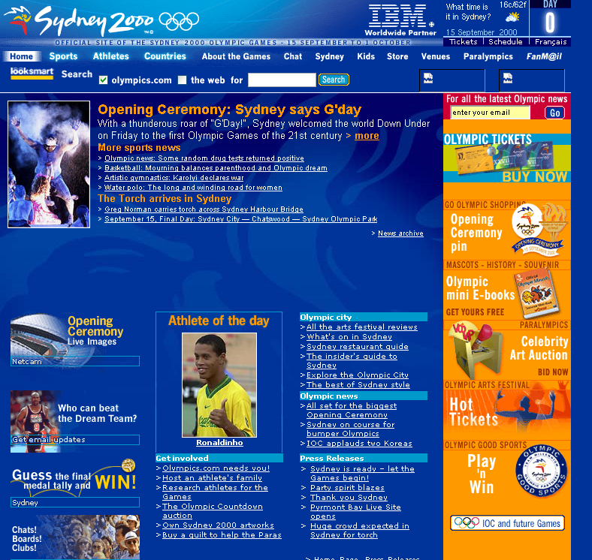
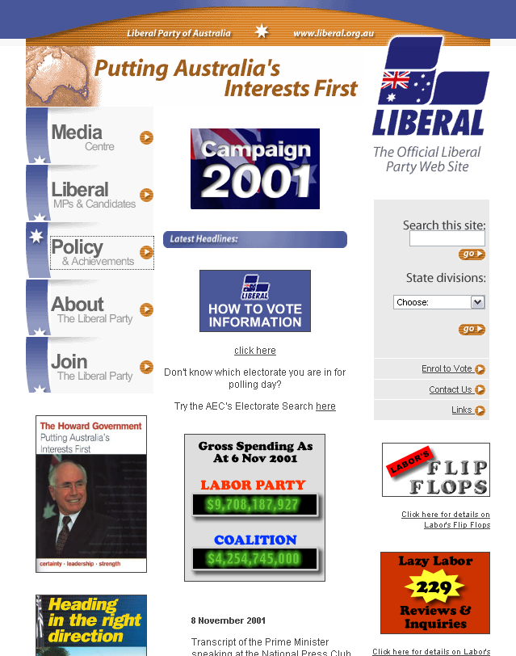
PANDORA
Preserving and Accessing Networked Documentary Resources of Australia
Est. 1996 by NLA
10 participating institutions
Collects ‘culturally significant’ online publications with permission
51 million archived files fully accessible to the public
3 complete harvests of the .au domain since 2005

Slide 9
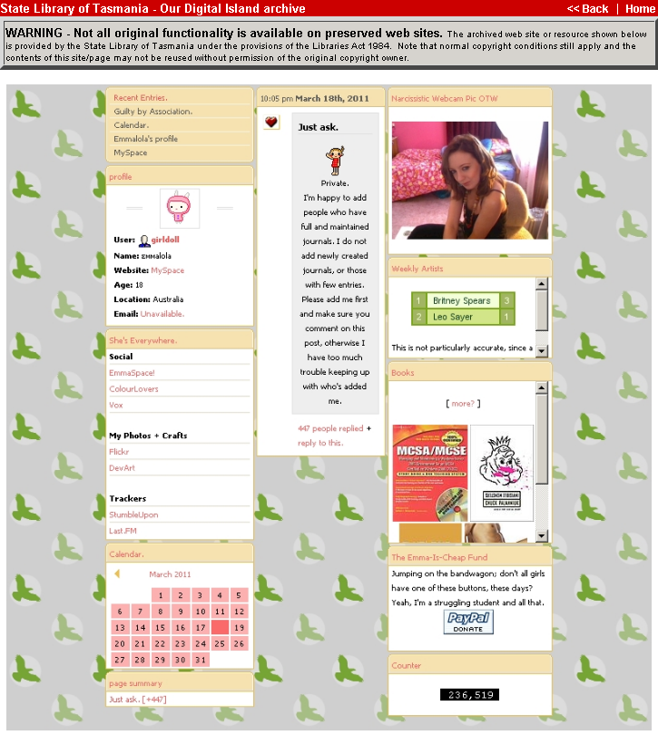
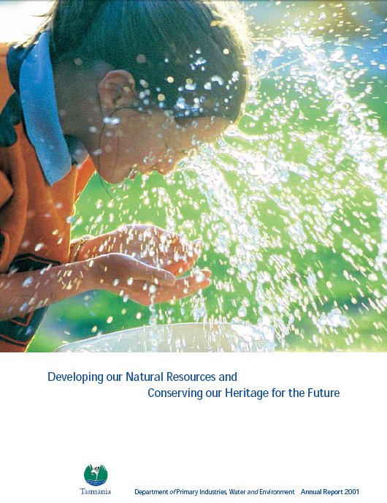
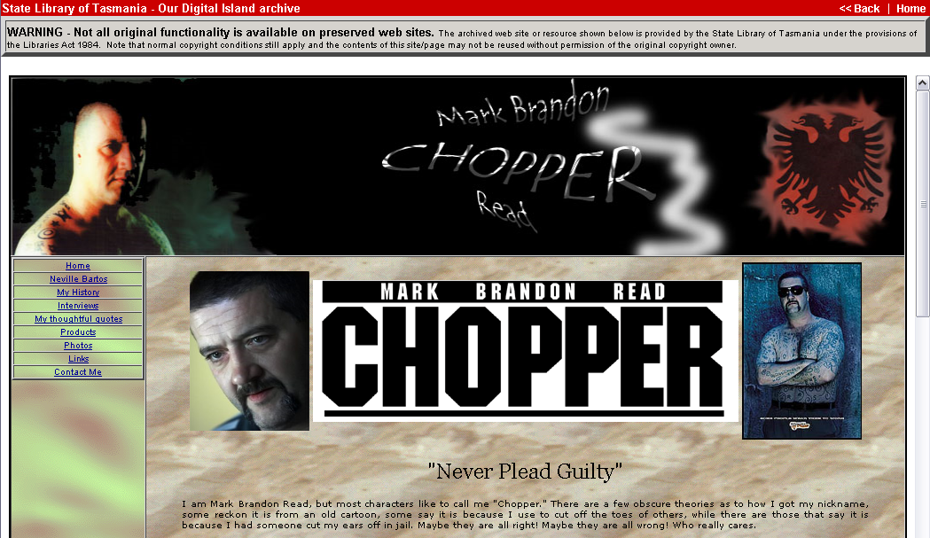
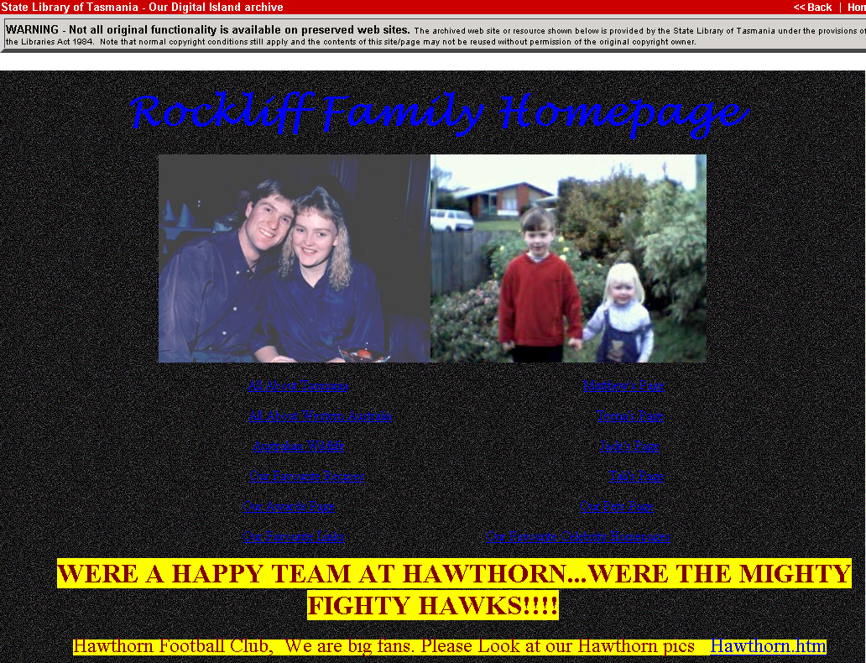
Our Digital Island
Est. 2000 by State Library of Tasmania
Archives Tasmanian websites
Does so under State legal deposit legislation
All material fully accessible to the public

Slide 10
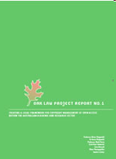
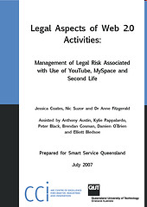

QUT ePrints
One example of ad hoc repositories developing across university sector
Deposit compulsory for all published works by QUT employees
Exception for commercial and confidential material
Copyright management left to author – but encourages OA licensing

Slide 11
Impediments and Solutions
Limited legal deposit – extension after AG’s paper?
Limits on exceptions - ‘commercially available’ in digital environment?
TPMs – very limited since USFTA
Contracts – legally grey area
Orphan works – is s200AB the solution?
Remote access – particularly important because of Australia’s geographic challenges
Government material – movement towards OA

Slide 12
Key Recommendations
Legislative changes to:
extend legal deposit to digital materials (deposit and harvest);
clarify how current exceptions work (eg multiple copying and format shifting);
provide TPM and contract exceptions; and
permit remote access to obscure works.

Slide 13
www.oaklaw.qut.edu.au
www.ip.qut.edu.au
OAK Law is funded by the Australian
Department of Education, Employment and Workplace Relations
Image: Blue by heyjoewhereyougoinwiththatguninyourhand from http://www.flickr.com/photos/heyjoewhereyougoingwiththatguninyourhand/69725913/ under a Creative Commons Attribution 2.0 licence

